Slide 1
ML Intro

Slide 2
https://ml-cheatsheet.readthedocs.io/en/latest/linear_regression.html

Slide 3
Some definitions
ML: “A computer program is said to learn from experience E with respect to some class of tasks T and performance measure P, if its performance at tasks in T, as measured by P, improves with experience E.” Mitchell, 1997
Algorithm: A method, function, or series of instructions used to generate a machine learning model. Examples include linear regression, decision trees, support vector machines, and neural networks.
Model: A data structure that stores a representation of a dataset (weights and biases). Models are created/learned when you train an algorithm on a dataset.

Slide 4
Some definitions
Parameters are properties of training data learned by training a machine learning model or classifier. They are adjusted using optimization algorithms and unique to each experiment.
Examples of parameters include:
weights in an artificial neural network
support vectors in a support vector machine
coefficients in a linear or logistic regression
Hyperparameters re higher-level properties of a model such as how fast it can learn (learning rate) or complexity of a model. The depth of trees in a Decision Tree or number of hidden layers in a Neural Networks are examples of hyper parameters.
They are not learned during a training session
They are predefined or chosen by comparison, typically through cross-validation

Slide 5
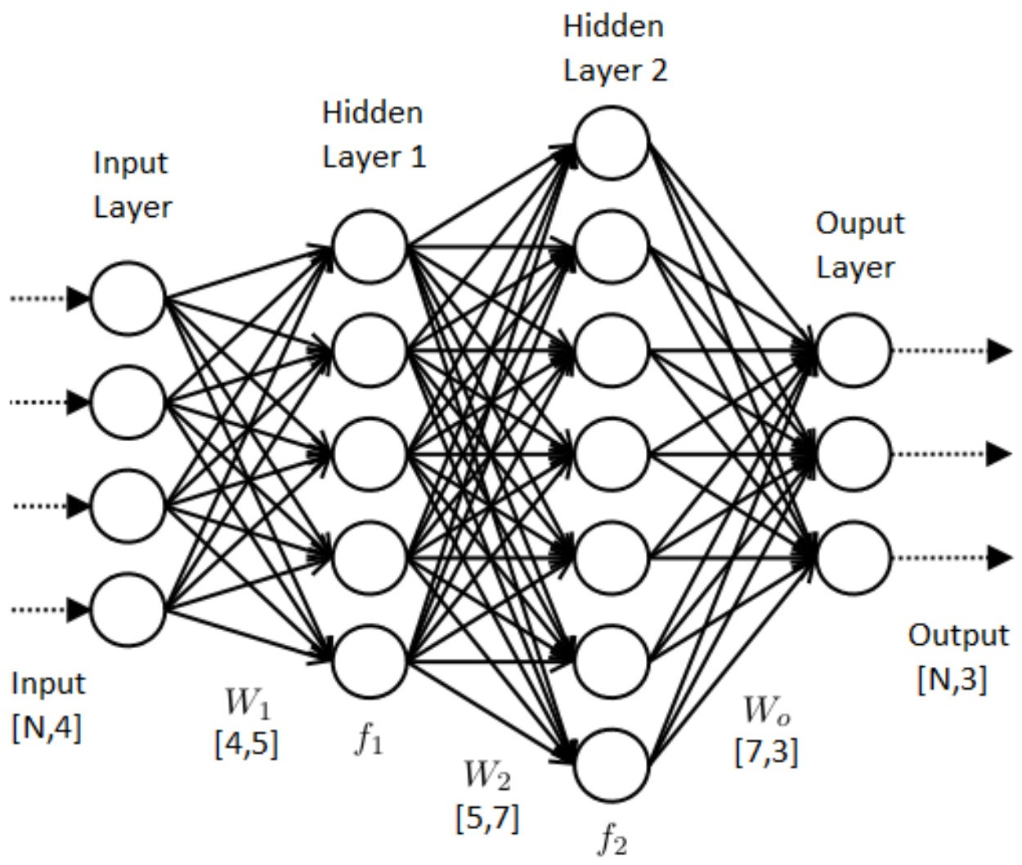
Neural network example

Slide 6
Some definitions
Loss = true_value(from data-set)- predicted value(from ML-model) The lower the loss, the better a model (unless the model has over-fitted to the training data). The loss is calculated on training and validation and its interpretation is how well the model is doing for these two sets. Unlike accuracy, loss is not a percentage. It is a summation of the errors made for each example in training or validation sets.
Typically used as cost function
Supervised learning:
Training a model using a labeled dataset.
Unsupervised learning:
Training a model to find patterns in an unlabeled dataset (e.g. clustering).

Slide 7
Some definitions
Classification:
Predicting a categorical output.
Binary classification predicts one of two possible outcomes (e.g. is the email spam or not spam?)
Multi-class classification predicts one of multiple possible outcomes (e.g. is this a photo of a cat, dog, horse or human?)
Regression: Predicting a continuous output (e.g. price, sales).

Slide 8
Linear regression

Slide 9
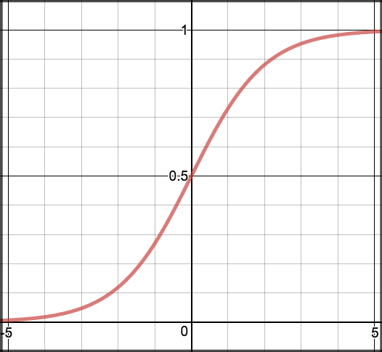
Logistic regression
Linear regression, then, a probability estimation is computed:
Sigmoid activation:
In order to map predicted values to probabilities, we use the sigmoid function. The function maps any real value into another value between 0 and 1.
In machine learning, we use sigmoid to map predictions to probabilities.

Slide 10
Logistic regression
z=W₀+W₁*Studied+W₂*Slept
P(class=1)=1/1+e^{−z}
https://ml-cheatsheet.readthedocs.io/en/latest/logistic_regression.html

Slide 11
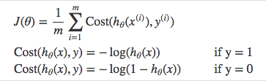
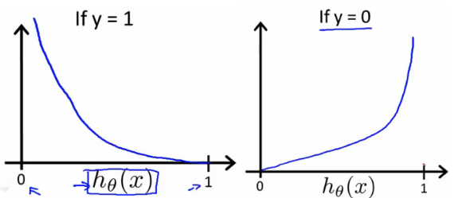
Logistic regression cost
The weights
Cross entropy, or log loss
Prob. predicted by the logistic regression
High costs for wron decisions

